Slide 1

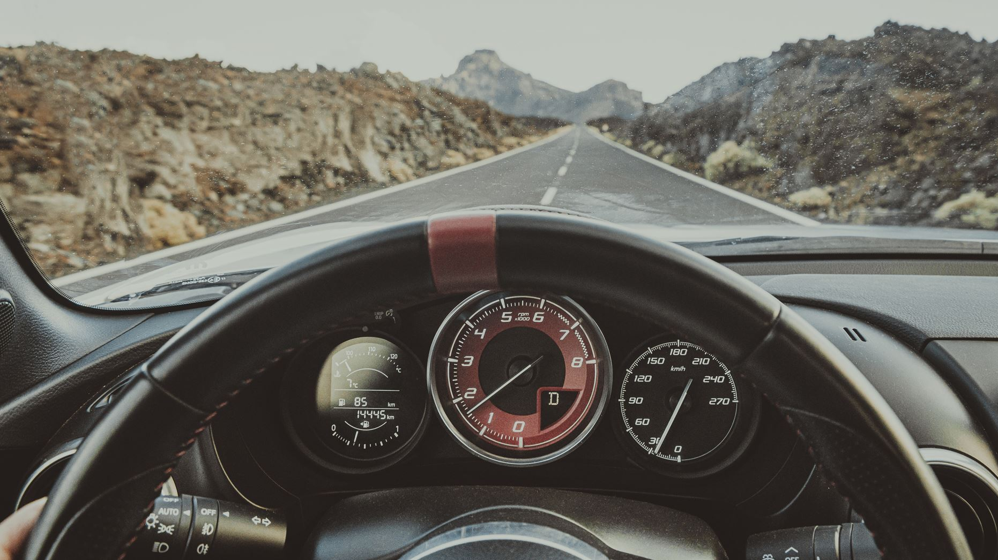




Real-time Driver Drowsiness detection using Embedded system
Presented by:
Kashish jain
K.Laxman
Varshitha

Slide 2

AGENDA:
Objective of project work
Existing system
Proposed system
Expected outcome

Slide 3
INTRODUCTION:
Vehicles accidents due to driver drowsiness –40% of highway accidents.
Drowsiness- fatigueness, lack of sleep.
Existing methods for drowsiness detection are not efficient.
AIM: To design a real time embedded system for drowsiness detection with minimized memory and computational overheads.

Slide 4
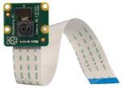
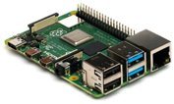
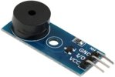
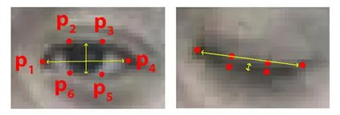
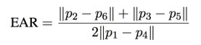
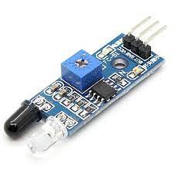
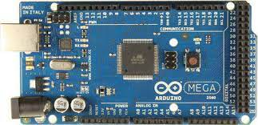
Raspberry pi Model:
Picamera: to capture real time video
Buzzer: to alert drowsy driver
Raspberry pi 4 board
EYE ASPECT RATIO:
An eye blink detection method.
Reduced overheads
IR sensor
Arduino mega board
Arduino Model:
Buzzer: to alert drowsy driver

Slide 5
BACKGROUND AND RELATED WORK
2016
Tereza Soukupova et al in 2016 used the eye-aspect ratio to detect the drowsiness of the driver
In paper "Arduino based real time driver drowsiness detection and mobile art sysem using bluetooth"they proposed a system for detecting drivers drowsiness on Arduino microcontroller board based on Atmega328P for real-time monitoring
Used IR sensor for detecting
Used low power and have low cost
2018
Rateb et al in 2018 detected drowsiness of a driver using neural networks
Archana et al detected driver drowsiness using eye blink sensor.
2019
In paper “The detection of drowsiness using a driver monitoring system” drowsiness system classified drivers' into drowsiness into low, moderate, and severe levels of drowsiness.
Limitations - could not classify drowsiness into moderate and severe levels of drowsiness.

Slide 6
In paper “Drowsiness Detection Based on Eye Closure and Yawning Detection”driver's eye movements and mouth movements are tracked using Haar cascade classifiers.
Results detected accurately in 85% of cases
HAAR Cascade : Machine learning approach where a lot of positive and negative images are used to train the classifier
Limitation :High false positive detection, Less accurate, Training custom object is hard
2020
In paper “Driver Drowsiness Detection System Using Computer Vision.” analyzing the eye blinks of humans using facial landmark detection by calculating eye aspect ratio
Results showed that system effectively detected level of eye openness.
Performance cost is low
In paper "Driver drowsiness and alcohol detection using arduino"
system detects driver drowsiness using eye blink sensor.

Slide 7
PROBLEM STATEMENT
FROM PREVIOUS WORK
To detect drowsiness of driver fingerprint, behavioral and physiological measures are used which need physical contact and are costly
We need an approach which is :
Has no human intervention
Process which is simpler and faster
Reliable
Accurate
Can be widely used
Low performance cost
Eye blinking detection is key to drowsiness detection
Here comes dlib library for face detection and facial landmarks detection - more accurate than Opencv.

Slide 8
Use eye aspect ratio to determine eye openness
OUR DROWSINESS DETECTION SYSTEM
Detect drowsiness – EAR in every frame in real time
Buzzer sound
CHALLENGES
Might have memory and computational overheads
Pi model can't be used 24/7
Consumes large memory
Gets heated early
Costlier
Need to overcome them

Slide 9










Raspberry Pi
Proposed Solution
Arduino Mega
Input Video (Live stream ) From Camera
Uses Infrared Sensor(IR) to capture eye blinking detection
Face detection algorithm(Dlib ) and Uses Machine Learning Dataset to train
Based on the eye blinking it sends signal to receiver ,doesn’t require to train the model
EYE Aspect Ratio (Calculate) using EYE detection of each frame from video, and it has to map with the .dataset of trained file too .
Just counts the signals or (0,1). The eye blink rate is continuously being monitored by using Arduino
If Drowsiness detected BUZZER else Repeat the process Continuously
if 0 appears MORE THAN 0.3s, it means driver is sleeping raise BUZZER else repeat the process in the case of 1 .
This is very Inefficient and there are computational and memory overheads ,not affordable and works for limited hours only
Simple computation and very efficient ,It works 24/7 and overheads are removed easily
Microprocessor
Micro controller

Slide 10

Did we Optimize ?
Board Raspberry Pi Pi without GUI Arduino Model
CPU % 13.2 1.3 0.4
MEMORY% 4.1 3.8 0.02
WORK ~2hr ~4hr ~24/7
PRICE
~5000Rs
~5330 Rs
~1780Rs

Slide 11
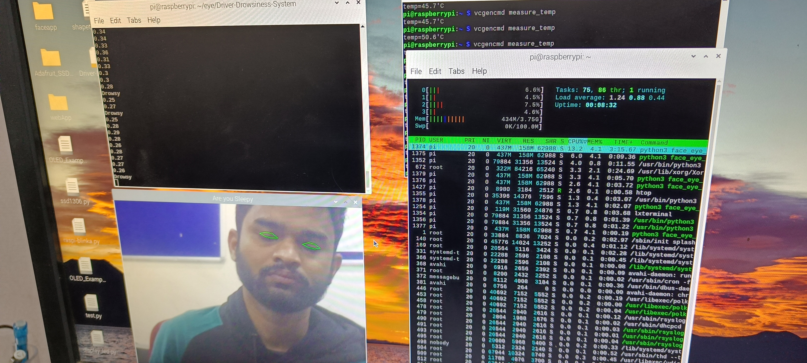
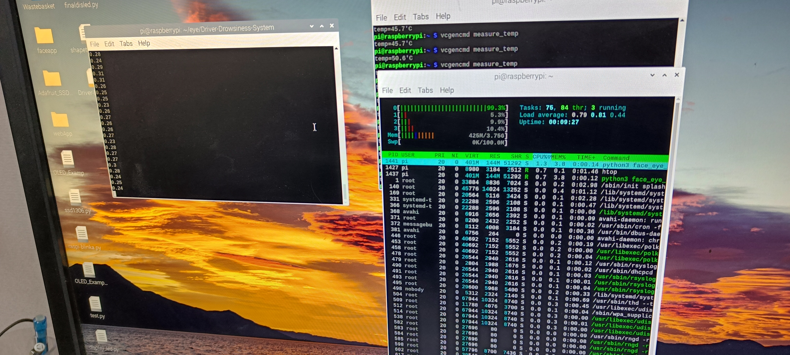
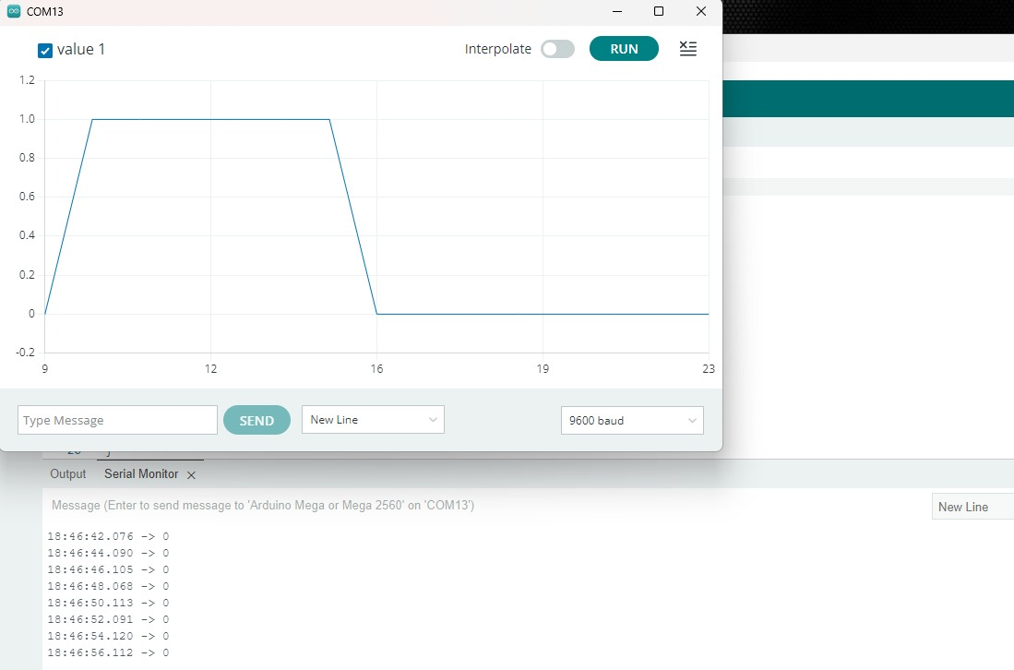
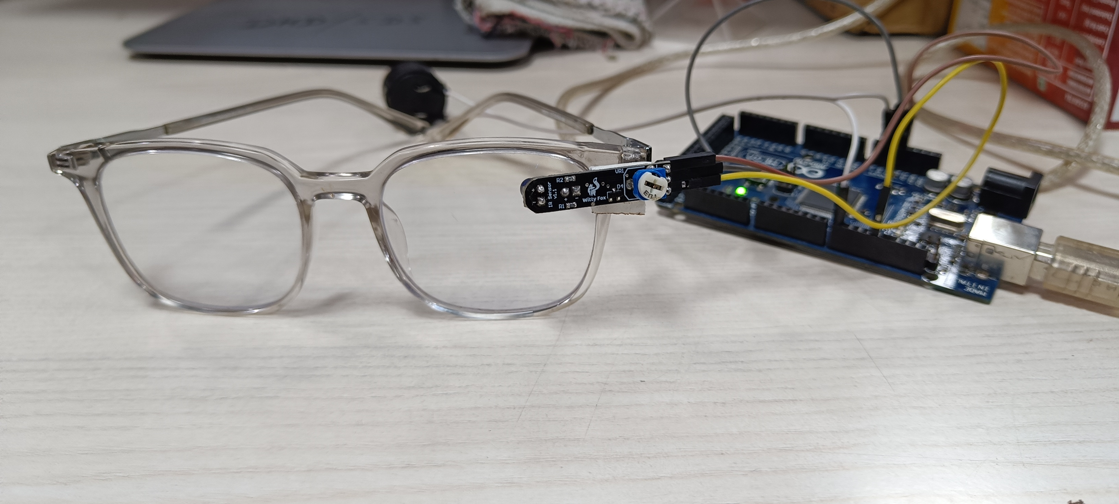
EVALUATION/RESULTS :
Raspberry with GUI
Raspberry without GUI
Arduino Mega Board

Slide 12







VS
RASPBERRY PI4
ARDUINO MEGA
Time is ~1.24ms
55%
85%
Time is ~0.30ms
LOAD AVG TIME
High Temp > worked less than 2 hrs.
50%
TEMP
95%
Works continuously for 24x7
Usage of CPU resources is very high which is inefficient .
50%
CPU %
75%
Very less Resource is used
Memory overhead is very high
50%
MEM %
100%
As we don’t need to process OS it takes less Memory
60%
88%
GUI is not needed to driver ,just BUZZER is enough
Needed Operating system for monitoring
GUI
20%
70%
We have replaced camera with IR Sensor which saves power consuming
Usage of ML algorithm and Pi camera is mandatory
CAMERA
2/5 Stars
5/5 Stars

Slide 13
CONCLUSION/FUTURE WORK :
Our model is cost effective, robust, efficient, can save lakhs of lives.
Our Prototype has limitation it doesn't work in night can be extended by adding night Vision IR Sensor.
Can Connect some alcohol detecting sensor (MQ3) which detects the ethanol % in the air .
At present the prototype needs to be connected to power source continuously ,it can be extended by adding battery and other components for making real time Embedded system.
This prototype can be implemented on Arduino uno or Arduino nano for more efficiency, less overheads and it is smaller in size which adds more convenience to user.

Slide 14

THANK YOU

Slide 15
References:
1 . Aditya Ranjan, Karan Vyas, Sujay Ghadge, Siddharth Patel, Suvarna Sanjay Pawar, “Driver Drowsiness Detection System Using Computer Vision.”, in International Research Journal of Engineering and Technology(IRJET), 2020
2 . Chris Schwarz, John Gaspar, Thomas Miller & Reza Yousefian, “The detection of drowsiness using a driver monitoring system” , in Journal of Traffic Injury Prevention (Taylor and Francis Online), 2019.
3 . Rahul Atul Bhope, “Computer Vision based drowsiness detection for motorized vehicles with Web Push Notifications”, IEEE 4th International Conference on Internet of Things, IEEE, Ghaziabad, India, 2019.
4. B.Mohana, C.M.Sheela Rani, “Drowsiness Detection Based on Eye Closure and Yawning Detection”, in International Research Journal of Engineering and Technology(IRJET), 2019.
5. Archana Jenis M.R M.E., Assistant Professor Soban Mathew. J “Driver Drowsiness and Alcohol Detection System Using Arduino.
6. Lestin Jills Joseph and Dr. Lokesha M, “Arduino based real time driver drowsiness detection and Alert System” september 2016

